Slide 1
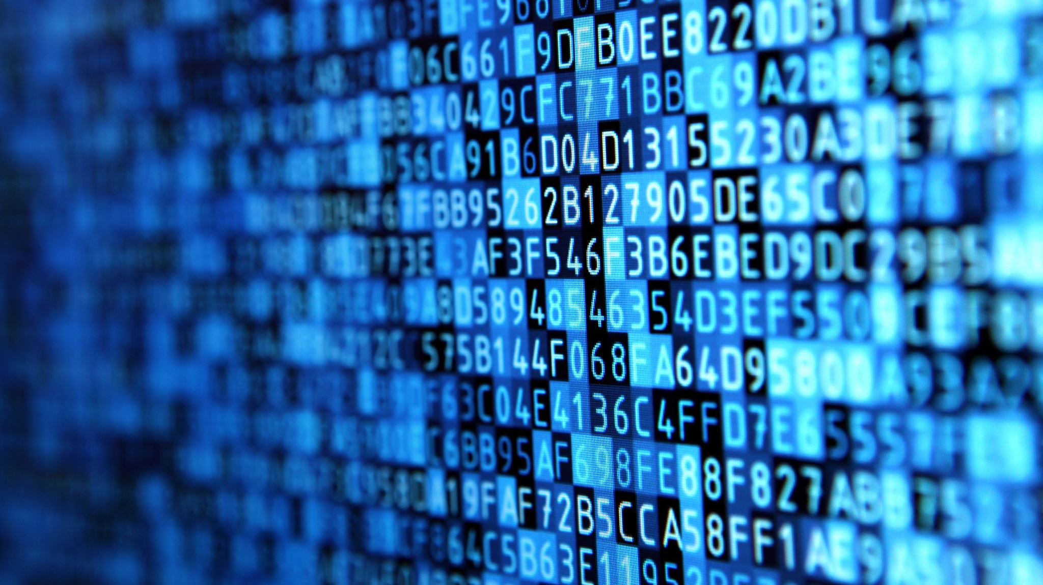
Cybersecurity in the Digital Age
Protecting Data and Privacy in an Increasingly Digital World Pfano Terresa Tshiambwa

Slide 2
Introduction to Cybersecurity
Definition of cybersecurity
Importance in today’s connected world
Examples of recent cybersecurity threats

Slide 3
Common Cyber Threats
Phishing attacks
Malware and ransomware
Data breaches and identity theft
Social engineering

Slide 4
The Role of Cybersecurity
Protecting personal and business data
Ensuring privacy and confidentiality
Safeguarding digital infrastructure

Slide 5
Best Practices for Cybersecurity
Strong passwords and multi-factor authentication
Regular software updates and patches
Safe browsing habits and avoiding suspicious links
Awareness and education

Slide 6
Cybersecurity in Business
Importance for companies and startups
Implementing security protocols
Employee cybersecurity training
Compliance and regulations

Slide 7
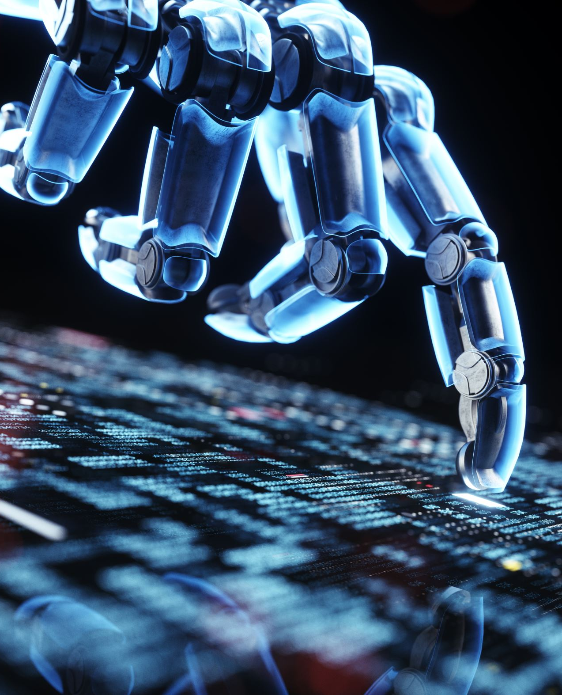
The Future of Cybersecurity
AI and machine learning in threat detection
Blockchain security innovations
Quantum computing and encryption advancements

Slide 8

Conclusion
Thank you!
Call to action: Stay informed & secure your data

